Slide 1
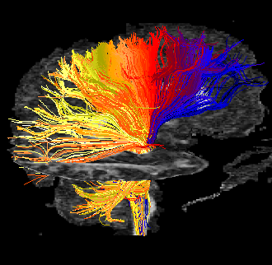

Deterministic Tractography
MP / NTP 651

Slide 2
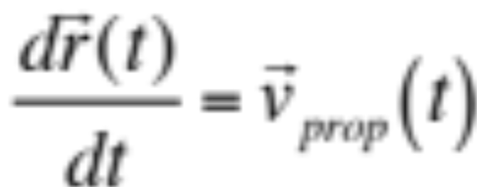
Streamline Methods
Steering or Propagation:
Streamlines (Mori 1999; Conturo 1999; Basser 2000)
Tensor Deflection (Westin 2002; Lazar 2003)
Tensorlines (Weinstein 1999; Lazar 2003)
Tract Integration:
FACT (Mori 1999)
Euler (Conturo 1999)
Runge Kutta (Basser 2000)

Slide 3
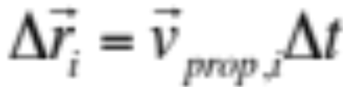
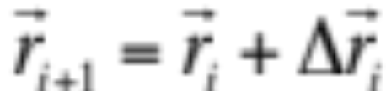
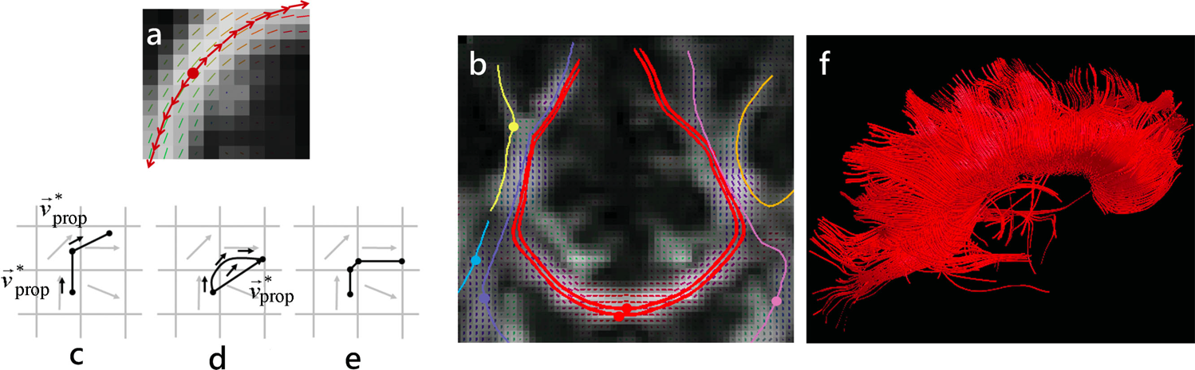
Streamline Methods
DTI:
v_{prop} = e₁ (major Eigenvector)
Lazar NMR Biomed 2010

Slide 4
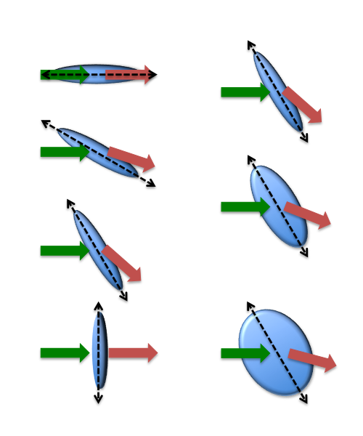
Tensor Deflection
TEND
Vprop=Vout=D.Vin
Lazar et al. Neuroimage 2003

Slide 5
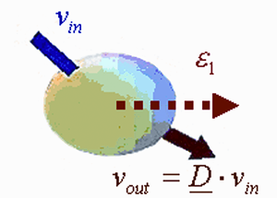
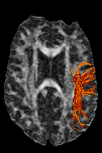
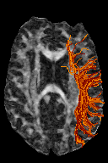
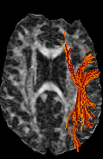
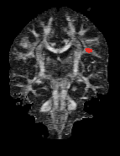
Comparison of Tractography Algorithms
Tensorlines (Weinstein et al. 1999):
V_{prop} = f e₁ + (1 - f )((1 - g)v_{in} + gD.v_{in})
f = 1
g = 0
streamlines
f = 0
g = 1
deflection
f = 0
g = 0.3
stiff deflection

Slide 6

Starting and Stopping
Starting (seeding):
User-defined region
“Whole-brain” seeding
“High” anisotropy (e.g., FA>0.2)
Multiple Seeds in Voxels (Superresolution)
Stopping:
Edge of brain volume
“Low” ansiotropy (e.g., FA<0.2)
“High” local curvature (e.g., bend >45º / step)

Slide 7

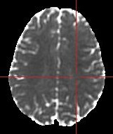
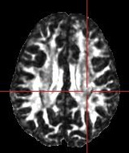
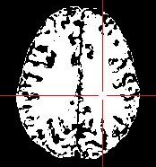
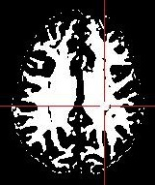
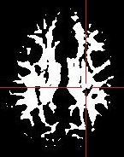
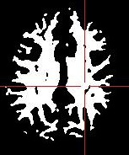
Stopping Constraints
Anisotropy thresholds – arbitrary
(changes with disease, development, noise)
MDC
FA
FA>0.1
FA>0.2
FA>0.3
WM SEG
2-channel
FAST
(MDC +FA)
Need Robust WM segmentation

Slide 8
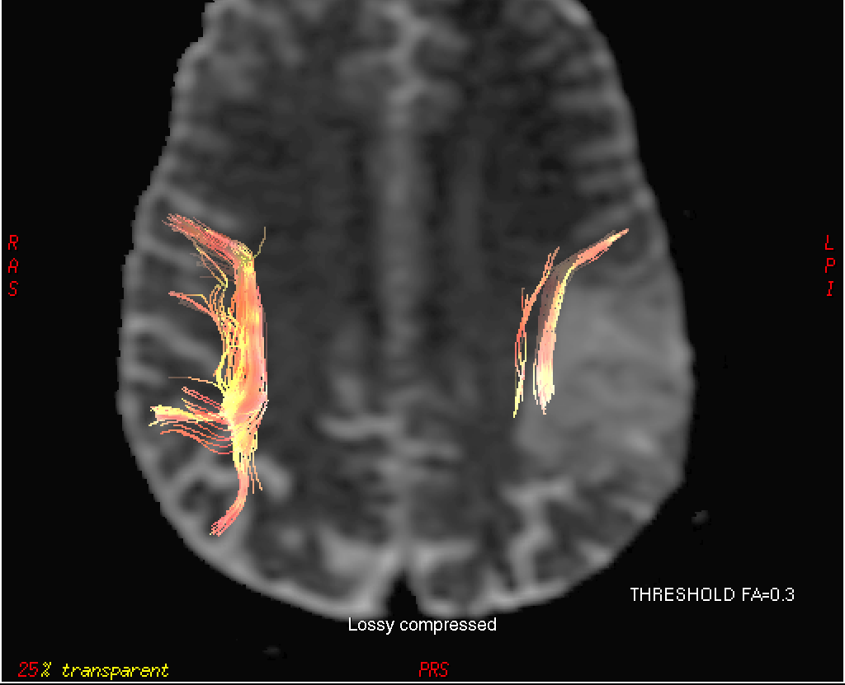

Number of trajectories and proximity to tumor margins vary with arbitrary stopping criteria
FA > 0.30
Courtesy: AS Field

Slide 9
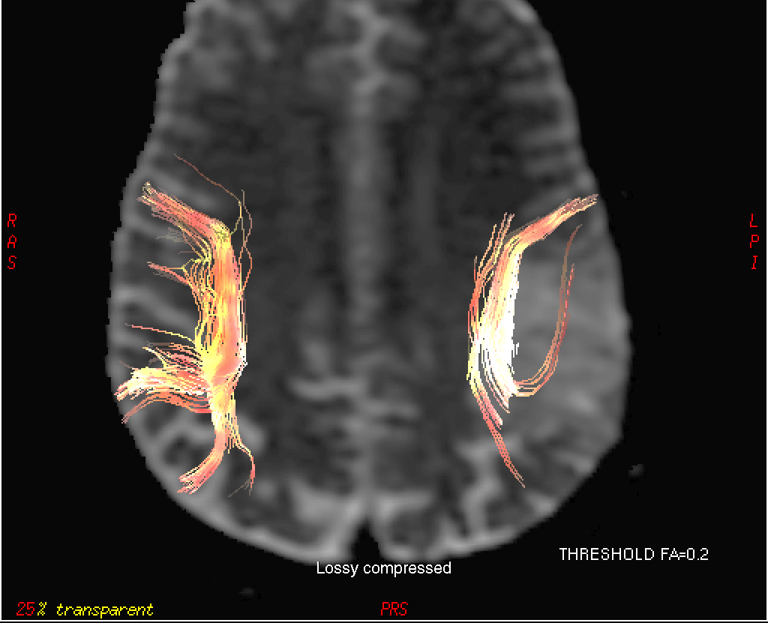
Number of trajectories and proximity to tumor margins vary with arbitrary stopping criteria
FA > 0.20

Slide 10

Number of trajectories and proximity to tumor margins vary with arbitrary stopping criteria
FA > 0.18

Slide 11
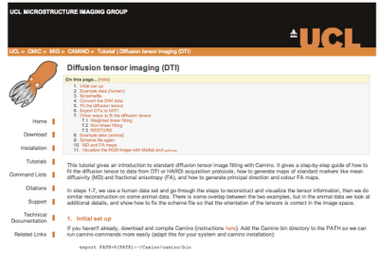
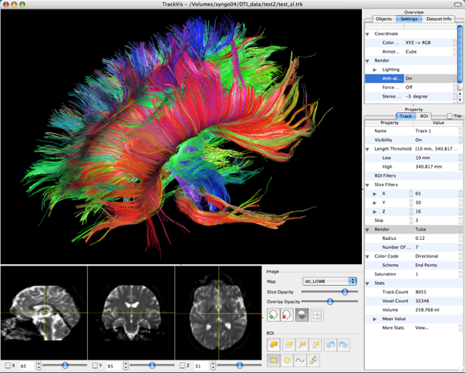
Tools for Deterministic Tractography
Camino
cmic.cs.ucl.ac.uk/camino/
(D. Alexander at UCL)
Trackvis
trackvis.org
(Wang & Wedeenat MGH)
Notes:
Camino – mostly command line functions for DTI, DWI and tractography
Trackvis – decent visualization tools for tractography

